Slide 1
Retail Performance Analysis
Retail,Sales & Inventory Dashboard
Presented by
Vaishnavi.K

Slide 2
Problem Statement
Retail businesses need to track sales performance, understand customer behavior and identify growth opportunities.
Analyze sales performance across stores and staff.
Identify high-value customers and buying behavior patterns.
Segment customers for targeted marketing.
Monitor inventory levels and product performance.
Create an interactive Power BI dashboard for management insights.

Slide 3
Project Overview
Objective
Generate actionable insights from retail transactional data using a multi-tool analytics approach.
Business focus
Sales performance, customer behavior, customer segmentation, inventory, products, stores and staff.
Core workflow
Excel → SQL → Python/ML → Power BI.

Slide 4
Dataset & Data Structure
Dataset
Retail Sales Data.
Tables
Customers, orders, order_items, products, brands, categories, stocks, stores and staffs.
Customers contain buyer and location information; orders contain transaction, staff and store references.
Order_items contain detailed item information; products, brands and categories describe merchandise.
Stocks track inventory across stores, while stores and staffs represent the organizational structure.

Slide 5
Excel
Data Cleaning & Preparation
Standardize column headers and text formats.
Remove duplicate records and handle missing values using filters and formulas.
Convert dates and numeric fields into correct formats.
Apply data validation for consistent order-status values.
Create derived total_price using list price, quantity and discount.
Use VLOOKUP/XLOOKUP to merge product information.
Create PivotTables and identify pricing outliers.
Export cleaned sheets as CSV files for SQL import.

Slide 6
SQL
Database Management & Querying
Create relational tables based on the ERD with appropriate constraints.
Import cleaned CSV files into SQL.
Join orders, order_items and products for detailed order analysis.
Calculate total sales by store and identify the top 5 selling products.
Create customer purchase summaries and spending brackets.
Analyze staff revenue and identify products with stock below the alert threshold.
Prepare a customer_segments table for later machine-learning results.

Slide 7
Python
Load orders, order_items and customers from SQL using pandas.
Perform exploratory data analysis using describe(), info() and value_counts().
Create charts with Matplotlib/Seaborn.
Calculate customer RFM features: Recency, Frequency and Monetary value.
Apply customer segmentation using clustering where used.
Export segmentation results back to SQL as customer_segments.

Slide 8
Power BI Dashboard
Connect Power BI to SQL and establish relationships between tables.
Sales overview: total sales over time, monthly sales trend and total orders.
Top-products analysis by revenue or quantity.
Customer purchase analysis by city or state.
Sales-by-store geographic map.
Low-stock alert cards and conditional formatting.
Interactive slicers for order status, product category and store.
Staff performance and consolidated KPI dashboard.

Slide 9
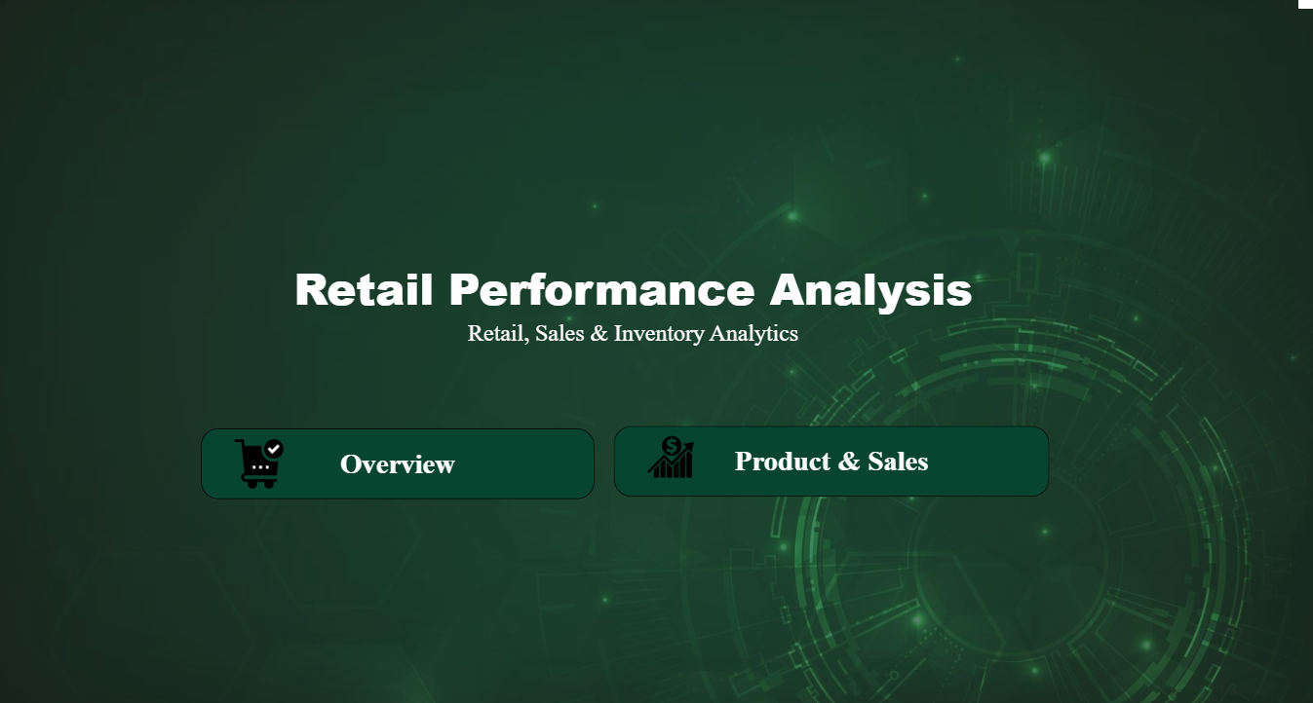

Slide 10
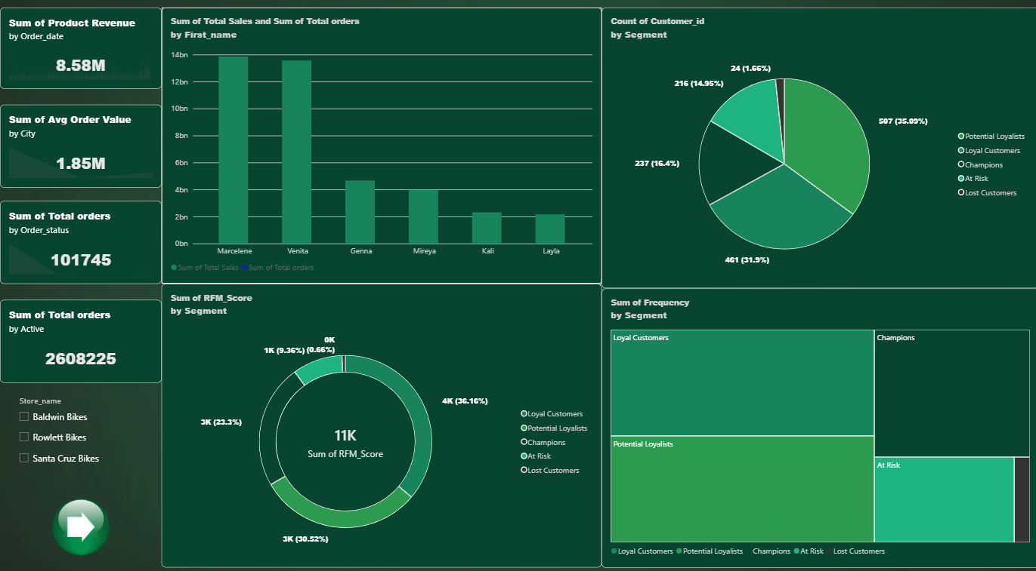

Slide 11
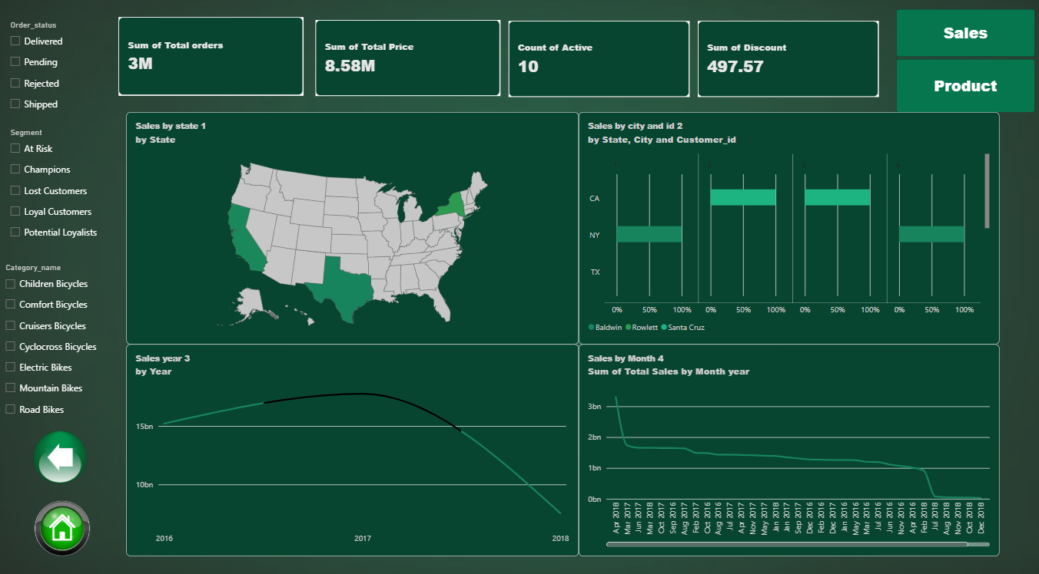

Slide 12
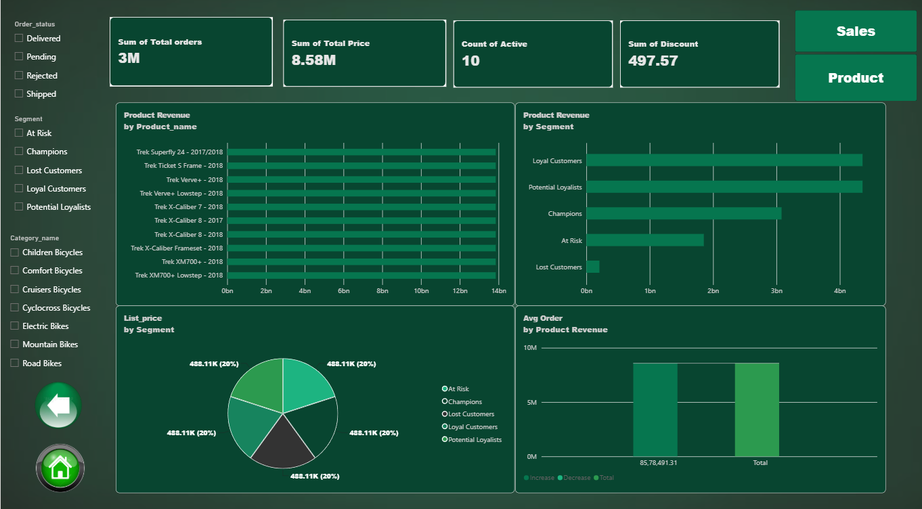

Slide 13
Conclusion
The project demonstrates an end-to-end retail analytics workflow using multiple data tools.
Excel prepares and validates the data, SQL manages and queries it, and Python supports EDA and segmentation.
Power BI converts the processed data into interactive business dashboards.
The combined workflow supports analysis of sales, customers, inventory, stores and staff and provides a foundation for data-driven retail reporting.

Slide 14
Thank you
for listening!

